Slide 1
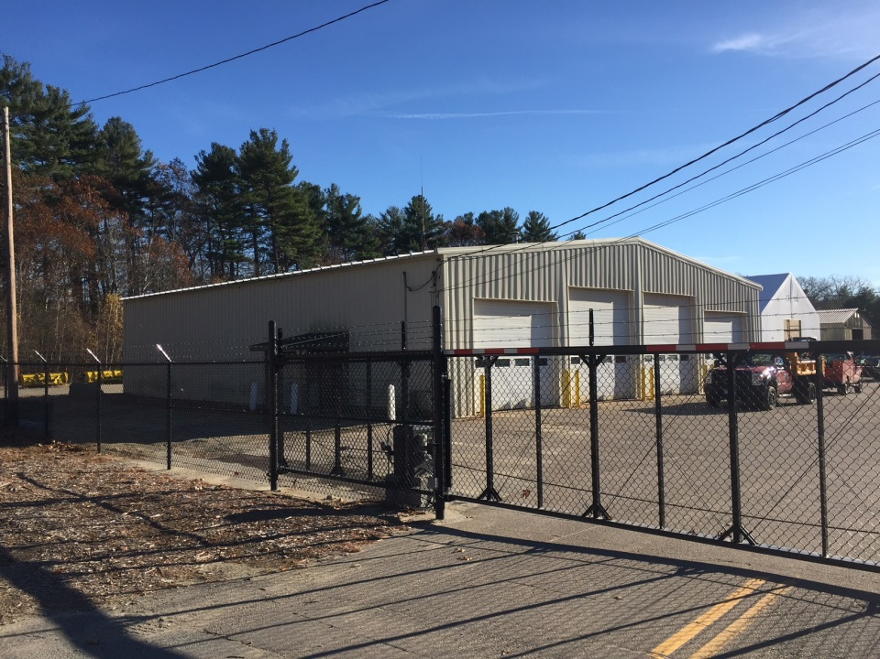


Town Hall Meeting
February 10, 2020
Municipality Facility Feasibility Study Update

Slide 2
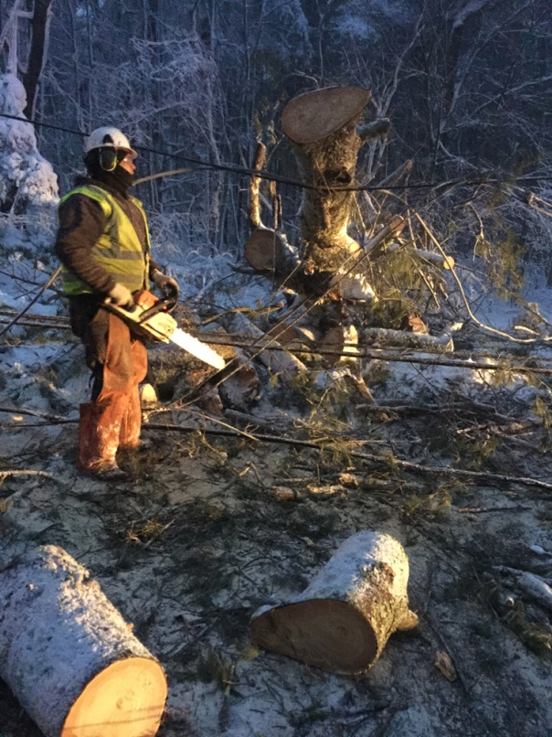
Goals/ Objectives
(Mission)
The [Town] Department of Public Works is dedicated to providing in a safe and cost effective manner the essential, emergency, and maintenance services, together with information and planning support, to protect, maintain, and improve the Town's assets and infrastructure for the safety and well being of the community
Insure delivery of critical public works services to keep pace with increasing town infrastructure maintenance responsibilities including preparedness for emergency response
Improve efficiency of operations to eliminate wasted time, unnecessary cost(s) to taxpayers and potential risk to public safety
Protect the town’s investments in vehicle and equipment fleet(s)
Provide safe working conditions for town employees in compliance with current codes and regulations
Improve energy-efficiency and employee productivity through consolidation of departments and adoption of best industry practices and guidelines for design of facilities
Town of Norwell
Municipality Facility Feasibility Study

Slide 3
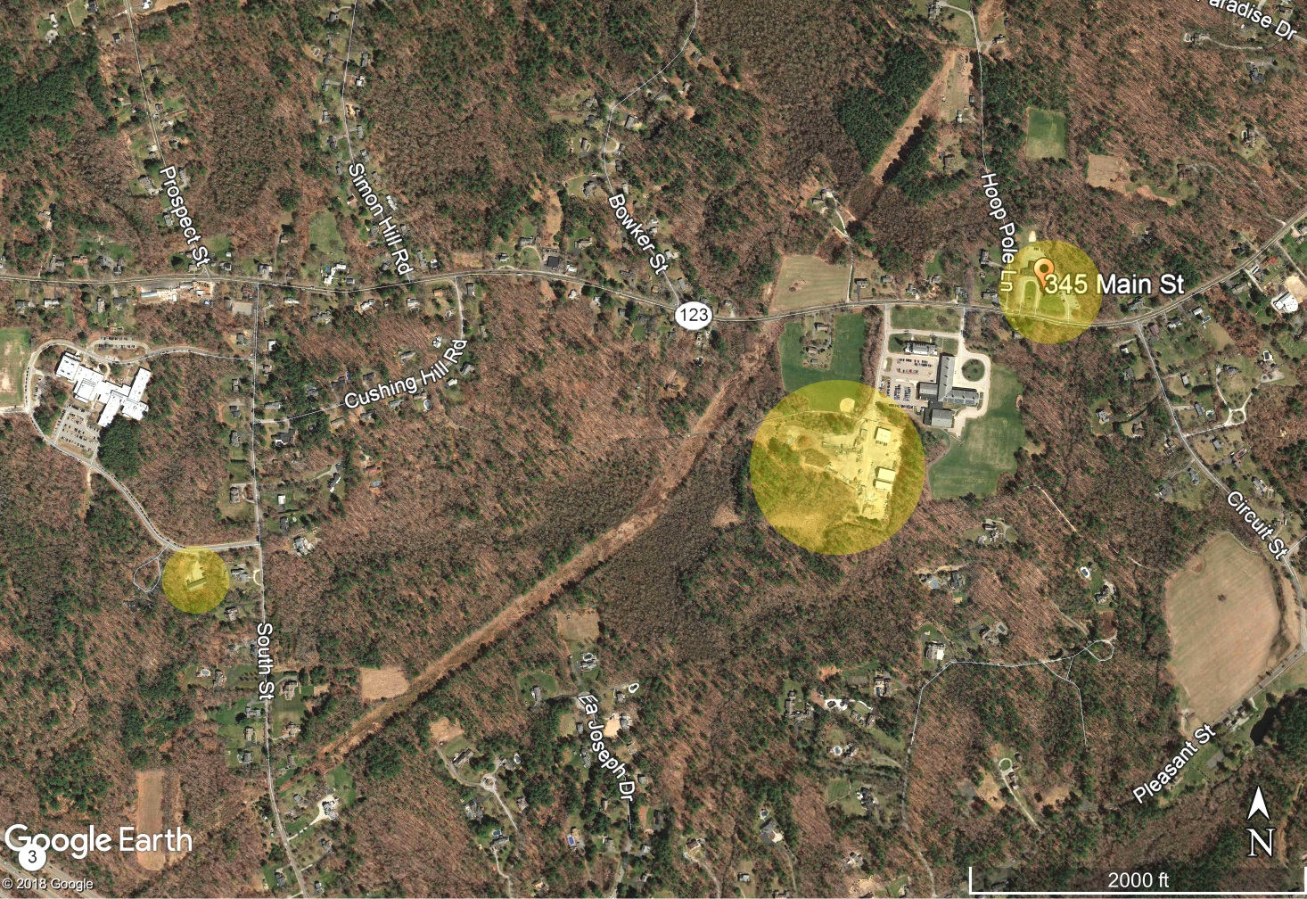
Operations Assessment/ Review
(How can operations be improved in Norwell?)
Existing
Highway, Tree &
Grounds
Administration
(at Town hall)
Existing
Tree & Grounds
(+/- 1.0 mile
from Highway Yard;
Town Hall)
Existing
Highway Yard
Town of Norwell
Municipality Facility Feasibility Study

Slide 4
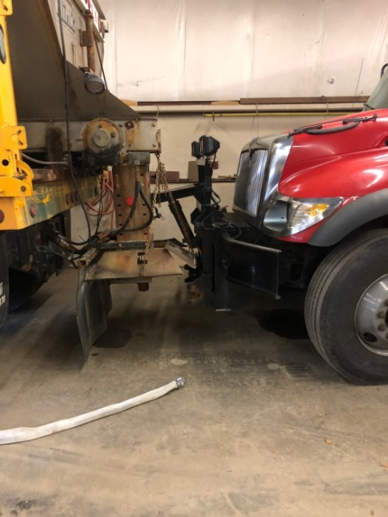
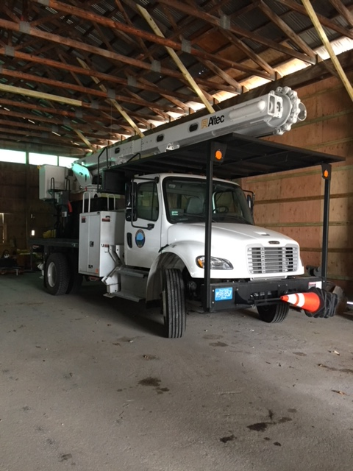
Existing Building Assessment
(Building Assessment)
Unsafe/ Inadequate vehicle and equipment storage area
Town of Norwell
Municipality Facility Feasibility Study

Slide 5
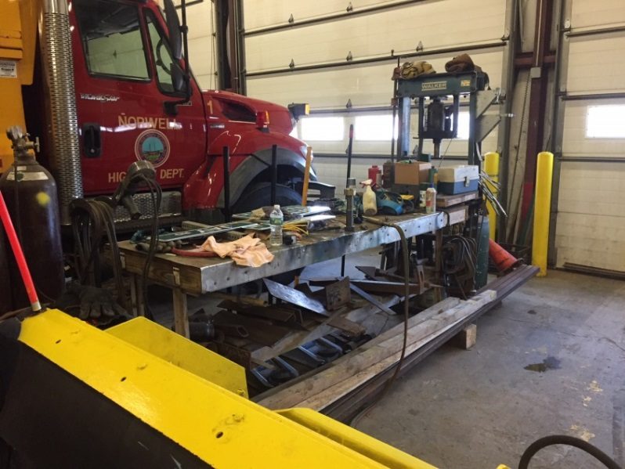
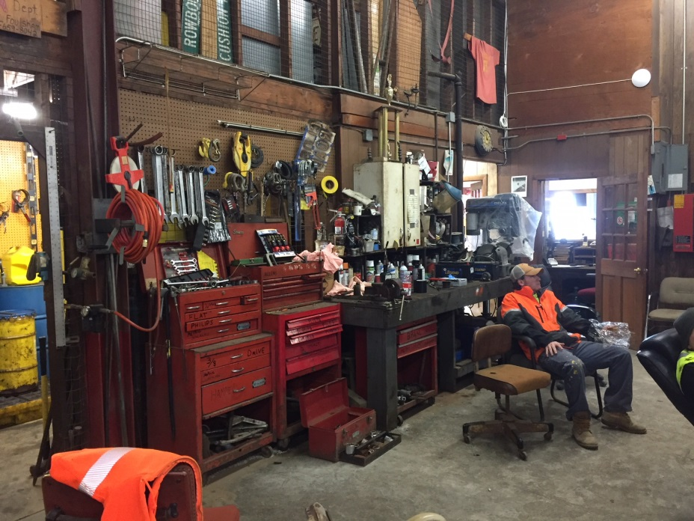
Existing Building Assessment
(Building Assessment)
Inadequate/ unsafe workspace conditions (welding station, workshops in shared area with vehicle storage)
Town of Norwell
Municipality Facility Feasibility Study

Slide 6
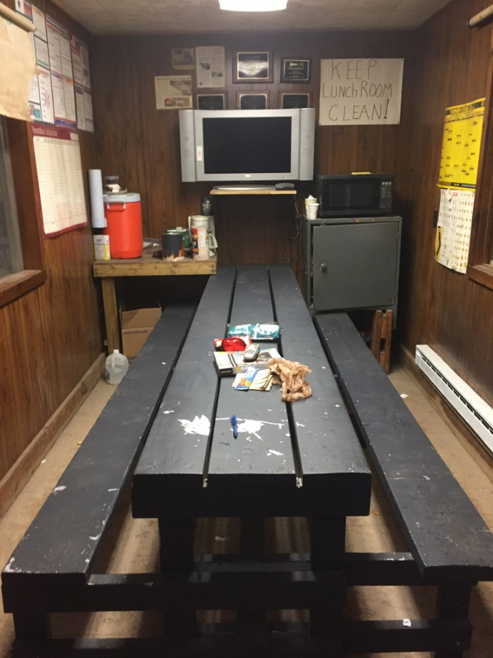
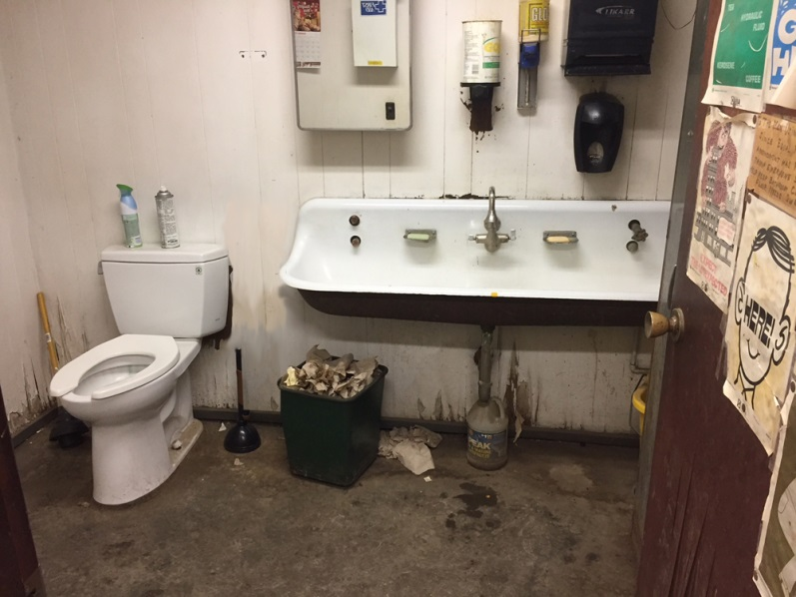
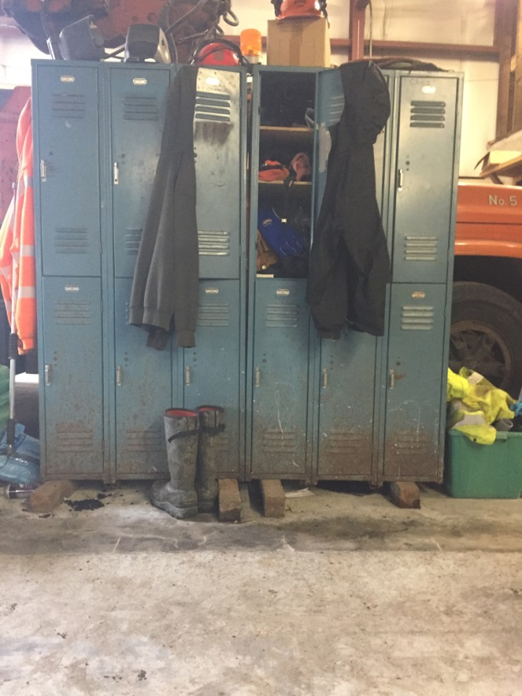
Existing Building Assessment
(Building Assessment)
Code non-compliant toilet facilities; no showers
Employee lockers located in vehicle storage area
‘Muster’ room undersized to accommodate state-mandated training; support storm emergency response
Town of Norwell
Municipality Facility Feasibility Study

Slide 7
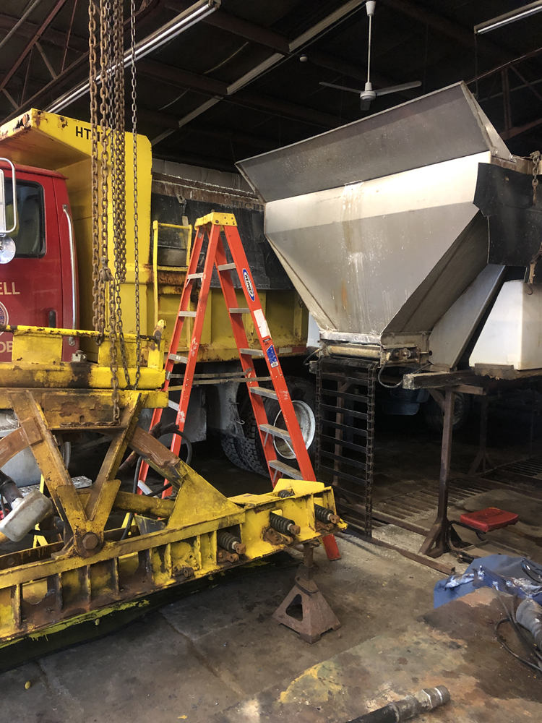
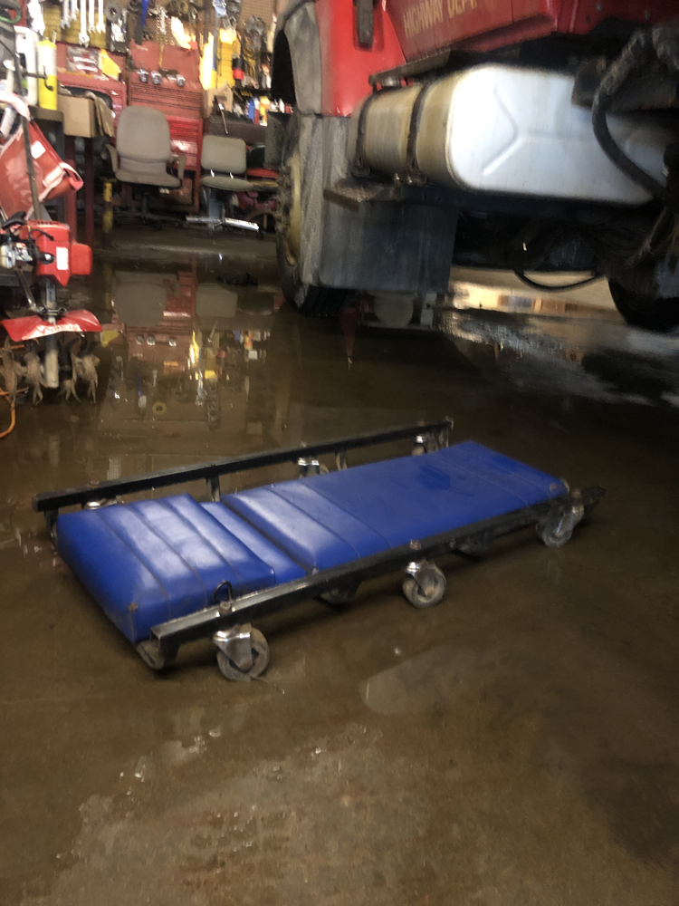
Existing Building Assessment
(Building Assessment)
Inadequate vehicle and equipment maintenance/ staging areas
Town of Norwell
Municipality Facility Feasibility Study

Slide 8
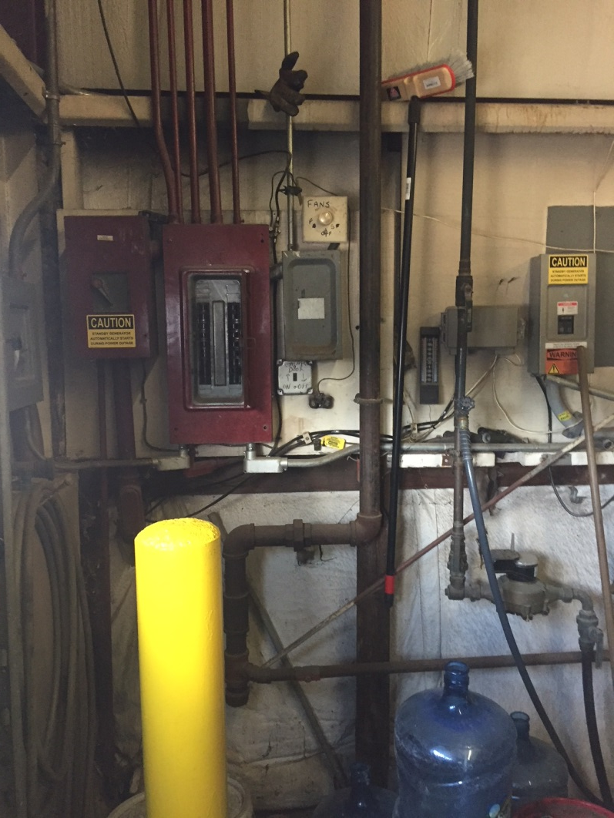
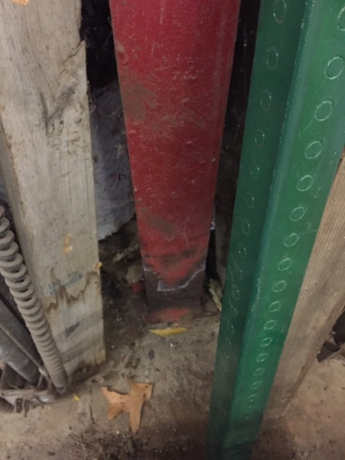
Existing Building Assessment
(Building Assessment)
Building condition
issues
Town of Norwell
Municipality Facility Feasibility Study

Slide 9

APWA (American Public Works Association) Guidance Position Statement, 2010
“First Responders are police, fire, emergency medical services and public works….”
Notes that public works are often the only public employees qualified and capable of providing services and labor during disaster recovery efforts
Urges governments to increase and earmark funding in budgets to improve public works disaster capabilities
Town of Norwell
Municipality Facility Feasibility Study

Slide 10
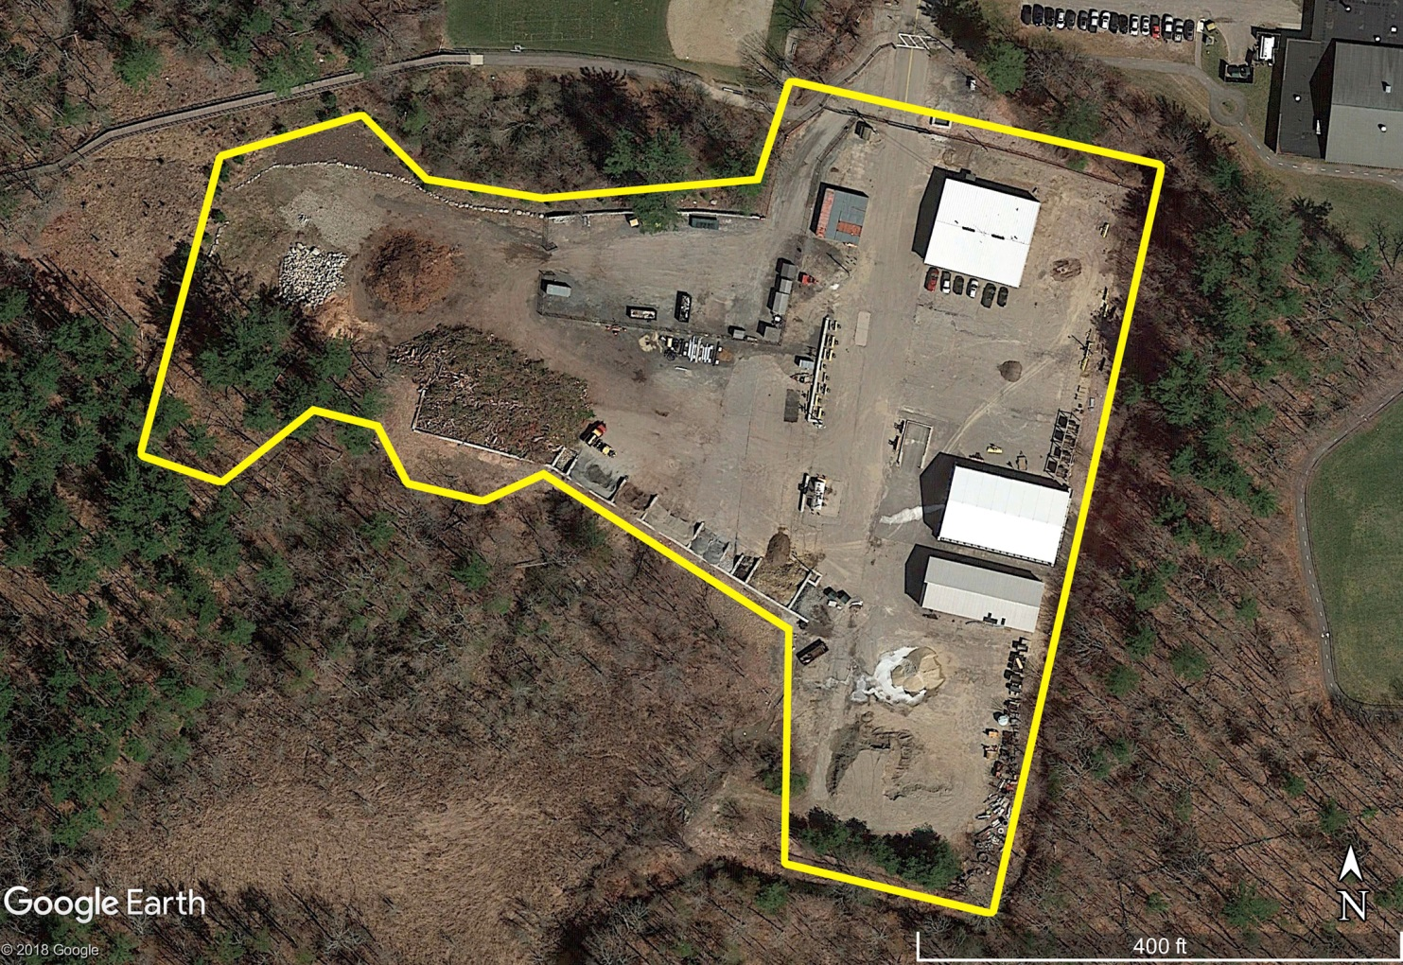
Shared Access from Main Street)
Existing Site Assessment
(Site Assessment – Highway Yard Existing Use)
Separate Recycle Entrance
Gate/ Secure Entrance
Recycle
(+/- 22,150 SF)
Highway
Overfow
Materials
Storage
Container
Storage
Town
Fueling
Station
Salt Ramp
Materials
Storage
Salt Shed
Limit of Site
Development
per DEP Agreement
(2016)
Old Salt Shed
(Outdoor Equipment Storage)
Overfow
Materials
Storage
Sand Shed
Town of Norwell
Municipality Facility Feasibility Study

Slide 11
Shared Access from Main Street)
Site Plan
(Option ‘12’)
Separate Recycle Entrance
Gate/ Secure Entrance
Recycle
(+/- 22,150 SF)
Parking
Areas
Overfow
Materials
Storage
Municipality
Facility
Salt
Ramp
Town
Fueling
Station
Materials
Storage
Salt Shed
Limit of Site
Development
per DEP Agreement
(2016)
Old Salt Shed
(Outdoor Equipment Storage)
Overfow
Materials
Storage
Sand Shed
Town of Norwell
Municipality Facility Feasibility Study

Slide 12
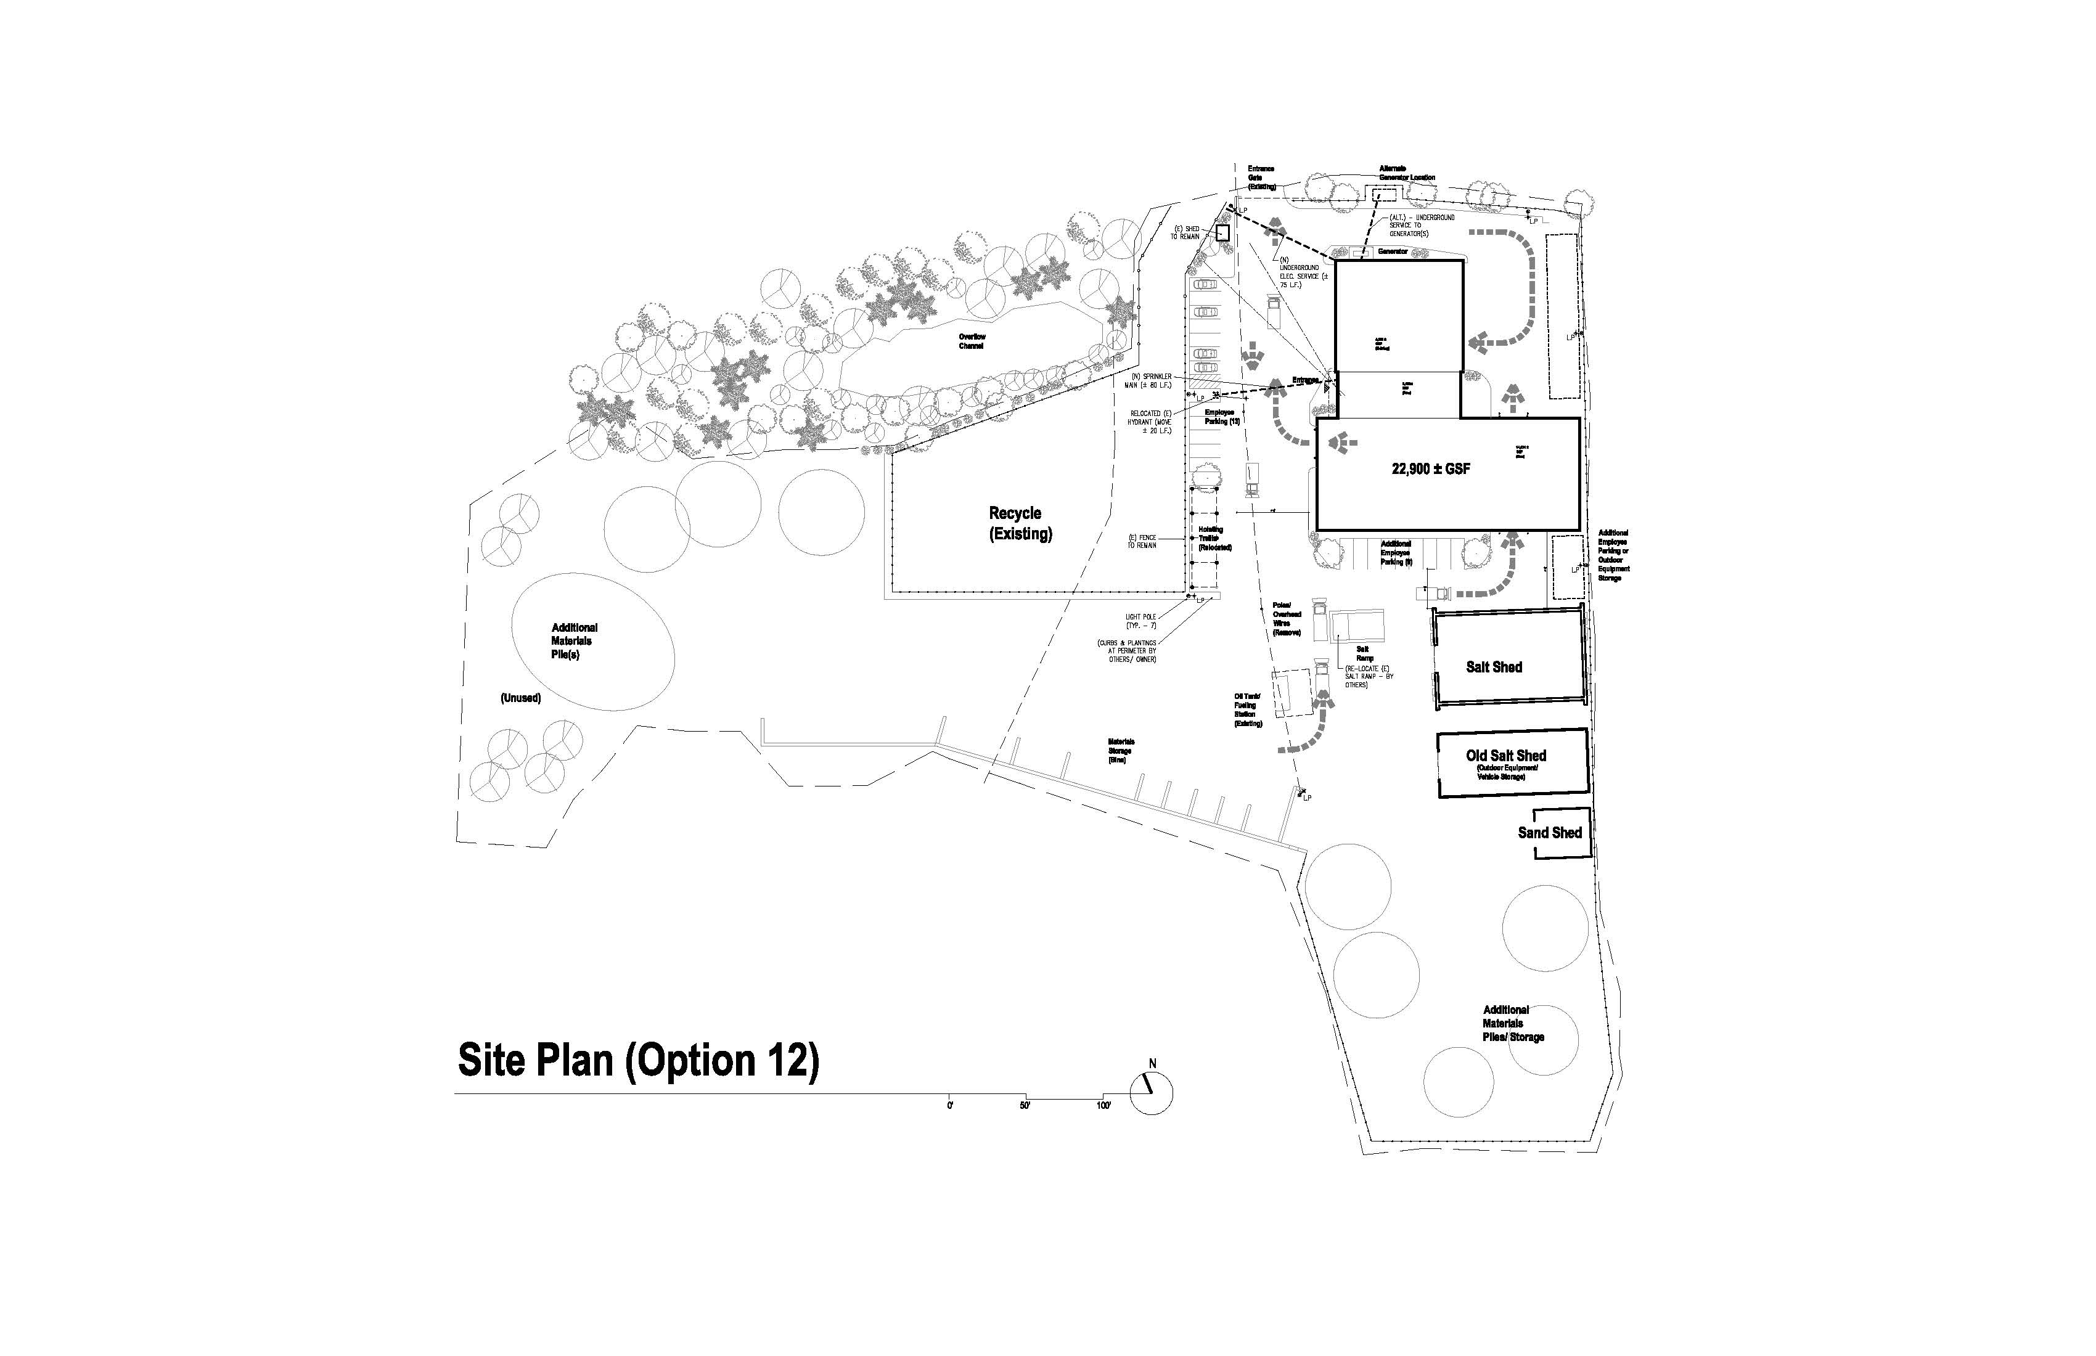
Site Plan
(Option ‘12’)
+/-
20,796 GSF
Old Salt Shed
(Outdoor Equipment Storage)
Town of Norwell
Municipality Facility Feasibility Study

Slide 13
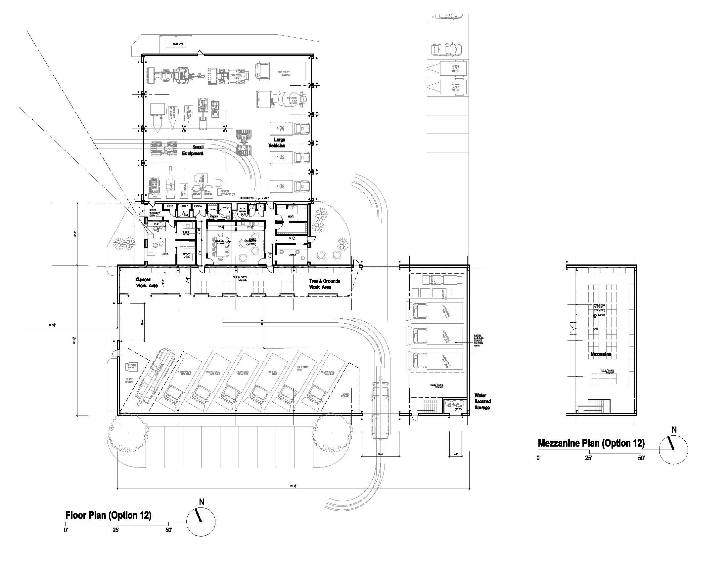
Option 12: +/- $5.5M
Administrative/Employee Areas: 2,396 SF
Workshops/Material Storage: 1,741 SF
Vehicle/Equipment Storage: 16,659 SF
Vehicle Maintenance: -0- SF
Wash Bay: -0- SF
Total: +/- 20,796 SF
Town of Norwell
Municipality Facility Feasibility Study

Slide 14
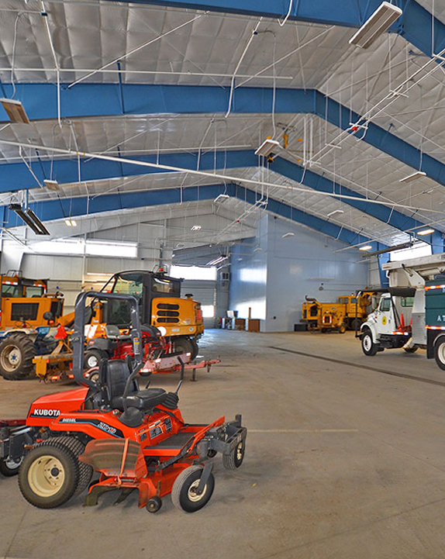
Operations Assessment/ Review
(What are other towns doing?)
Indoor Vehicle and Equipment Storage
Extends life of equipment
Improves emergency response (avoid winter freeze-ups; de-icing), vehicles can be stored with plows/ sanders already mounted
Promotes workplace safety for employees (limits risk of slip and fall, other workplace accidents)
Reduces fuel costs (less idling/ warm-up)
Environmentally compliant (fluid leaks contained)
Minimizes noise to abutting area
Security - protects vehicles and equipment from potential vandalism
Town of Norwell
Municipality Facility Feasibility Study

Slide 15
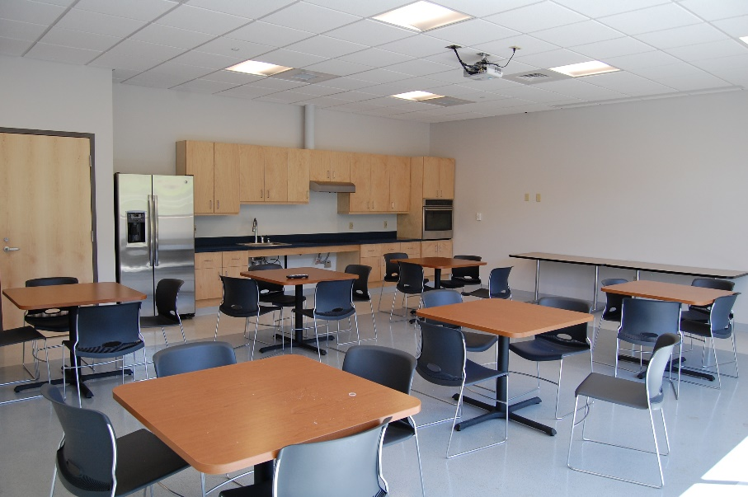
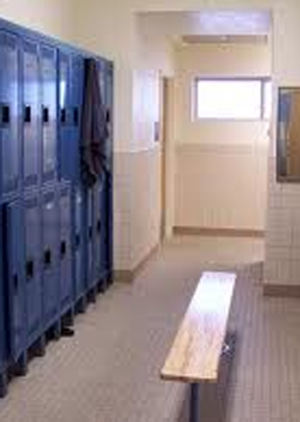
Operations Assessment/ Review
(What are other towns doing?)
Employee Facilities
Energy and cost efficiencies to combine and consolidate administrative areas in a single location
‘Muster’ room to support emergency storm operations and state-mandated employee training.
Adequate toilet, changing and showering facilities in compliance with current building codes
Promote a healthful workplace for employees (employee areas separated and properly ventilated from vehicle exhaust)
Town of Norwell
Municipality Facility Feasibility Study

Slide 16
Cost Assessment
Construction Cost Comparison
Hopkinton (2016) $13.8m 42,410SF $327/SF
Orleans (2017) $13.9m 42,278SF $331/SF
Boylston (2015) $ 4.7m 13,926SF $329/SF
Medford (2014) $15.3m 45,000SF $342/SF
Grafton (2018) $11.5m 35,430SF $392/SF
Andover (2017) $20.0m 54,088SF $371/SF
Pembroke (2019) $ 8.0m 28,540SF $283/SF
Berlin (2018) $ 4.7m 12,912SF $364/SF
Average Cost/ SF $342/SF
NORWELL (2021) $5.5m 20,796SF $264/SF
Town of Norwell
Municipality Facility Feasibility Study

Slide 17
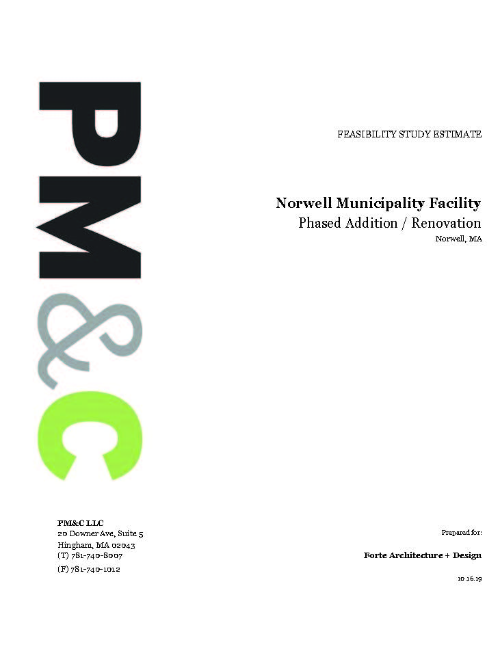
Town of Norwell
Municipality Facility Feasibility Study

Slide 18
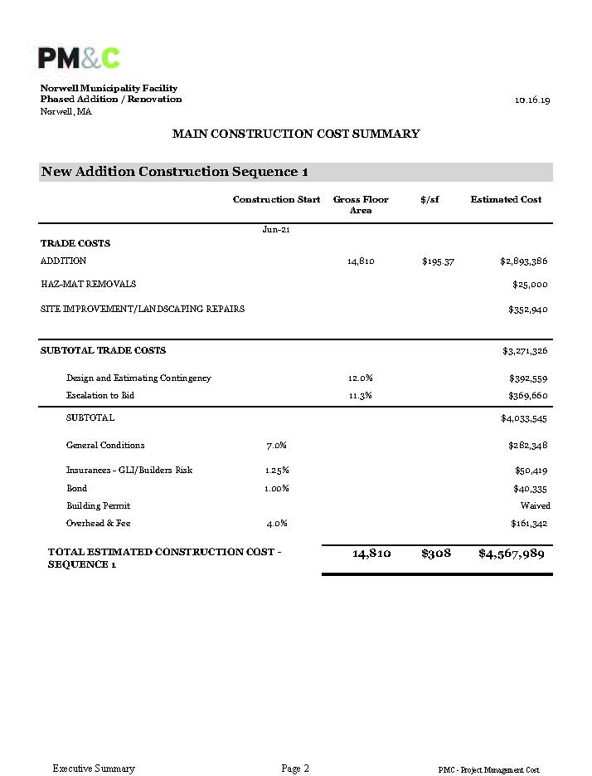
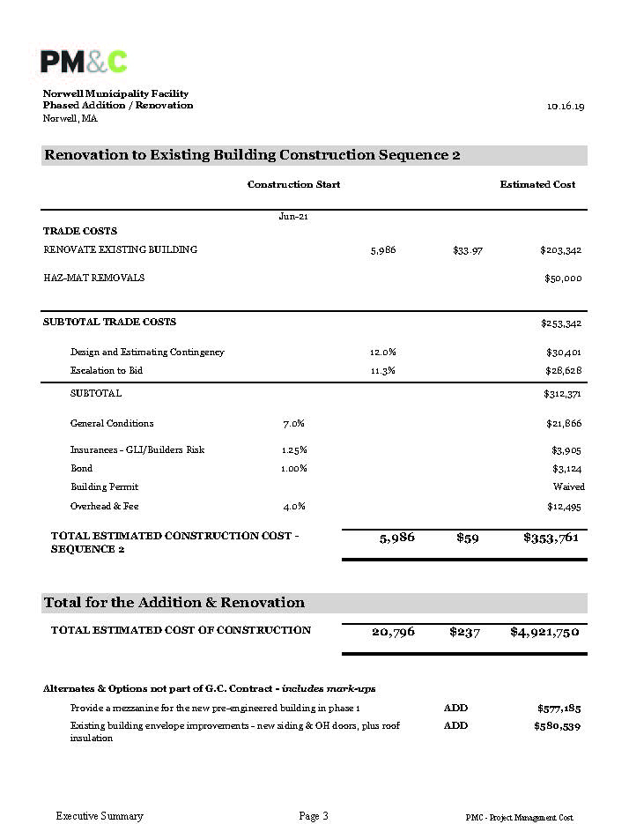
Town of Norwell
Municipality Facility Feasibility Study

Slide 19
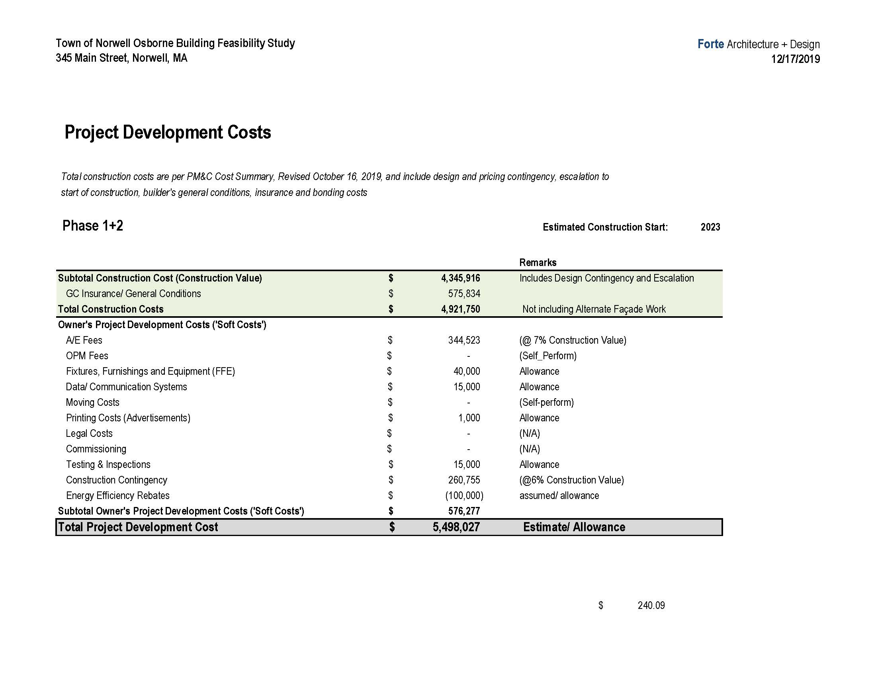
2021
Total Project Development Cost:
+/- $5.5M
Town of Norwell
Municipality Facility Feasibility Study

Slide 20
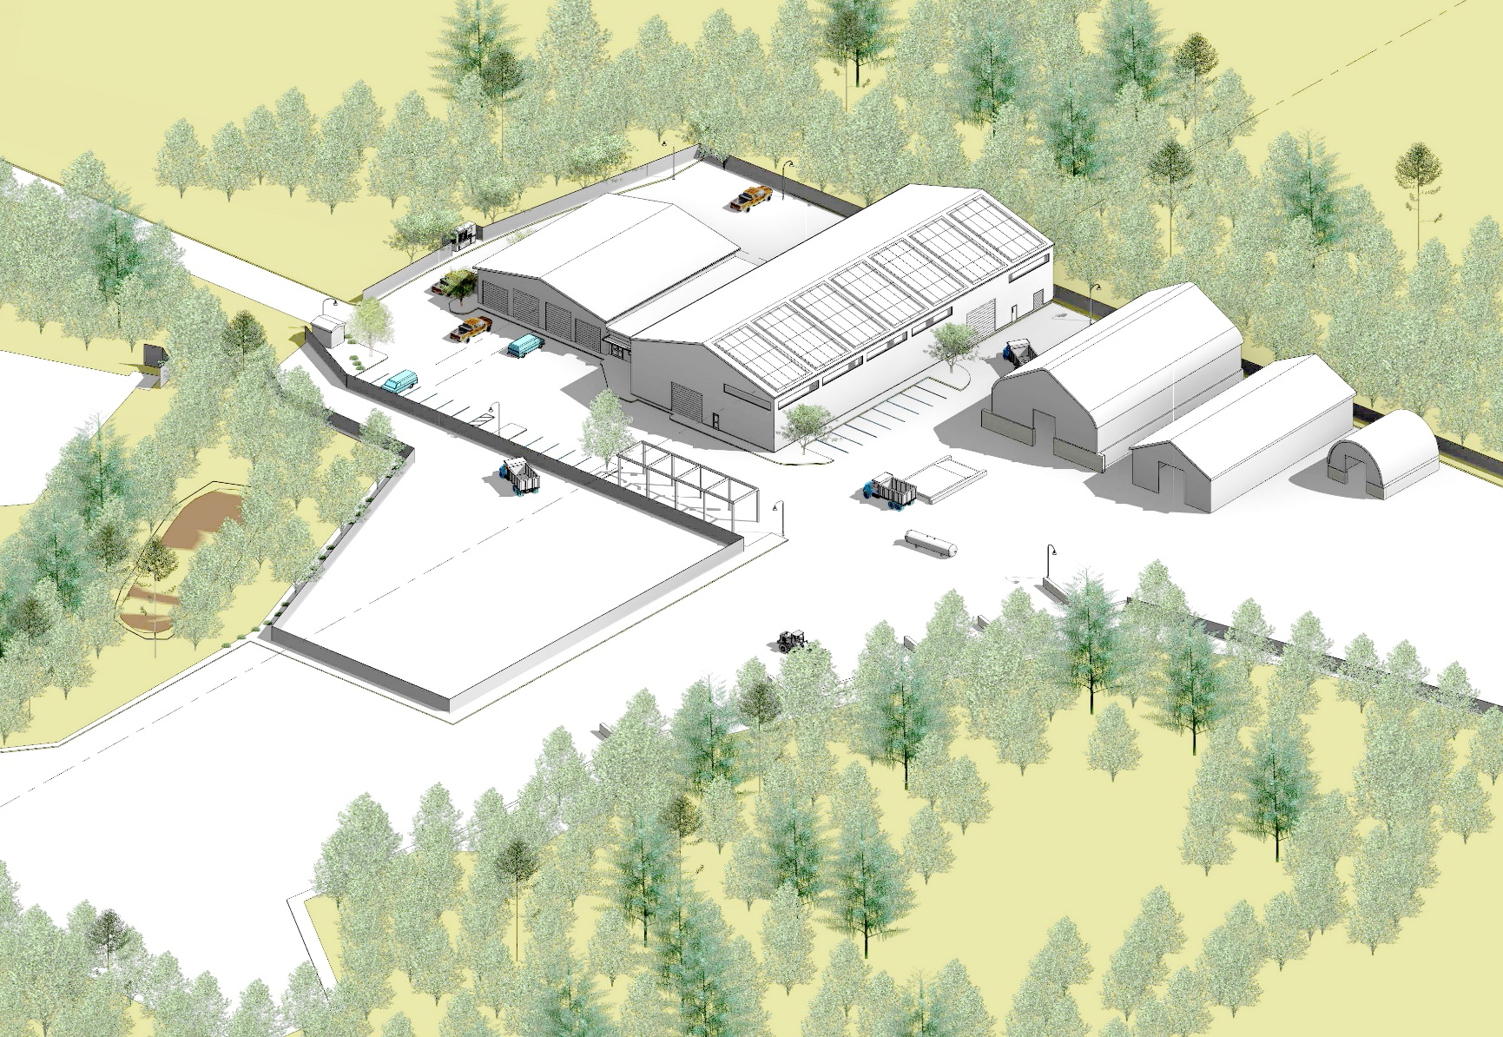
Town of Norwell
Municipality Facility Feasibility Study

Slide 21
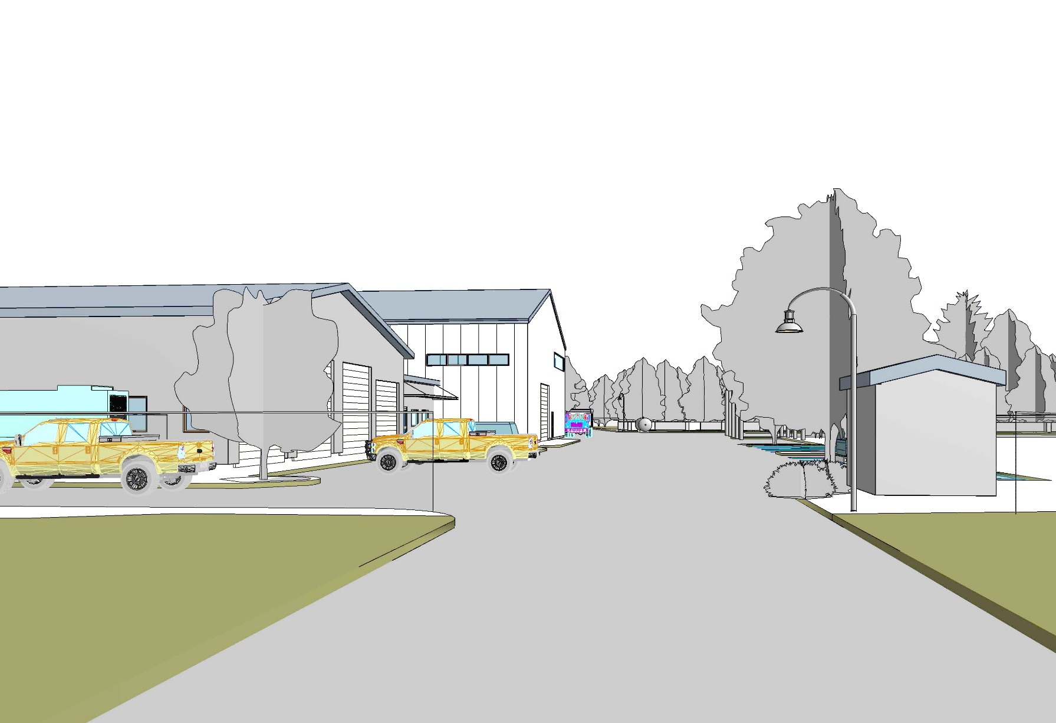
Town of Norwell
Municipality Facility Feasibility Study

Slide 22
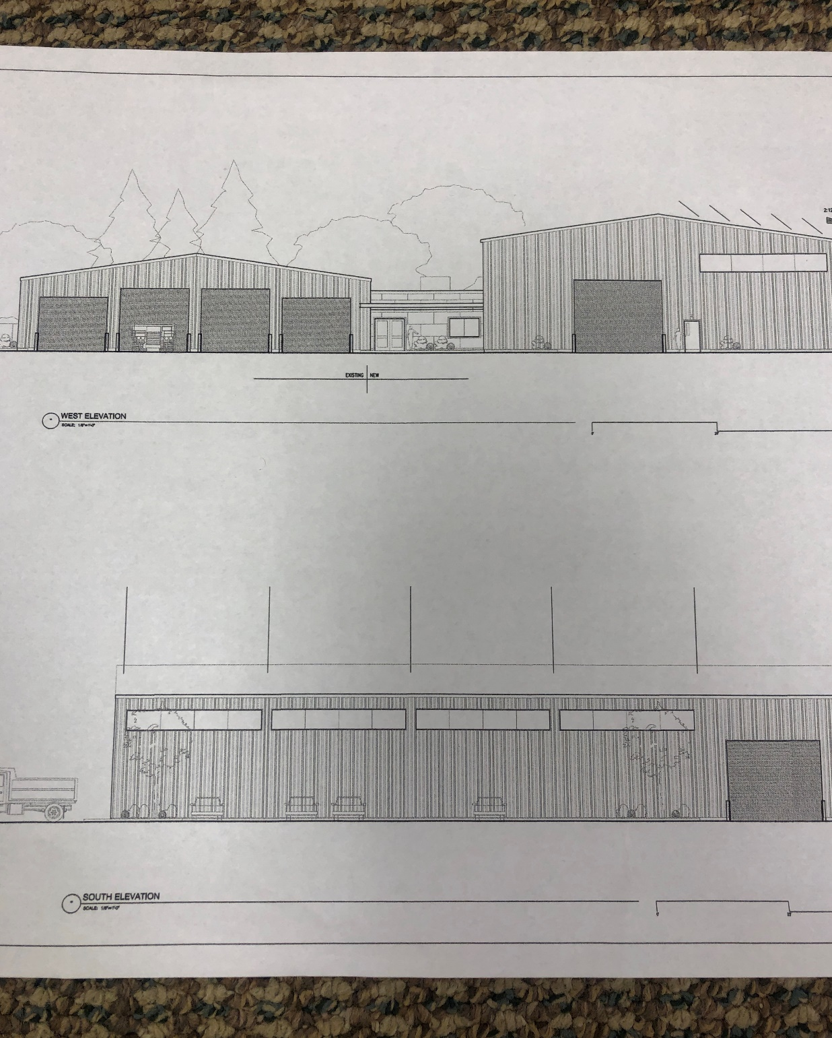

Slide 23
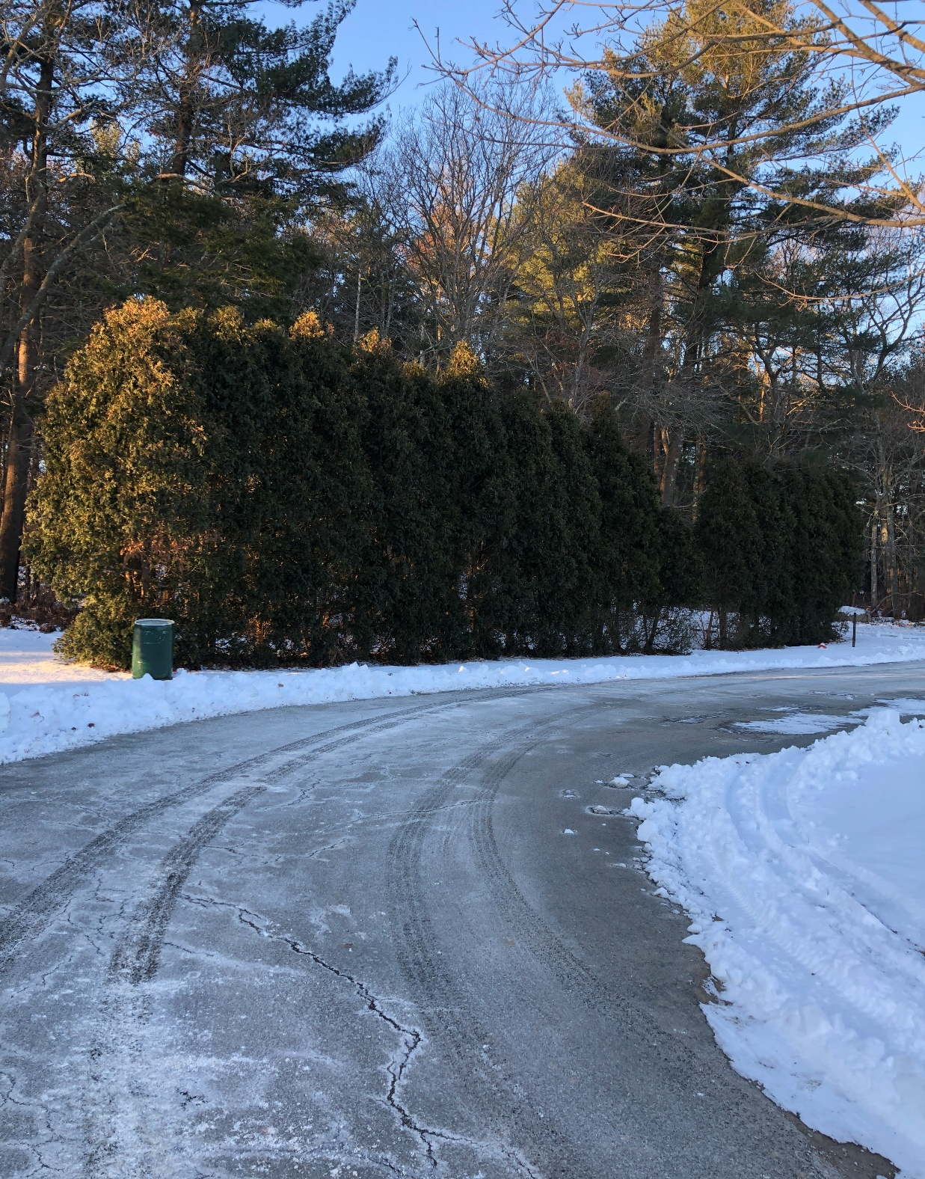

Slide 24
